Slide 1
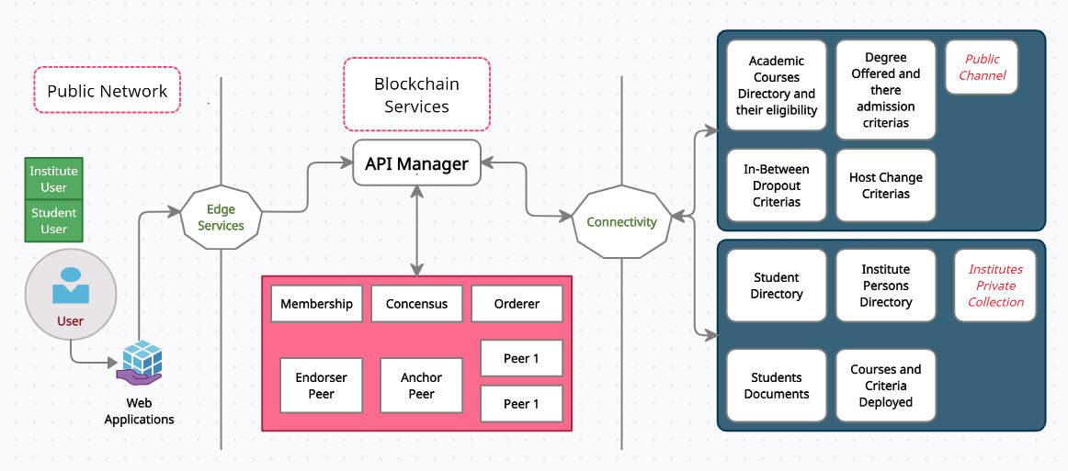
Blockchain Based Architecture for DESy

Slide 2
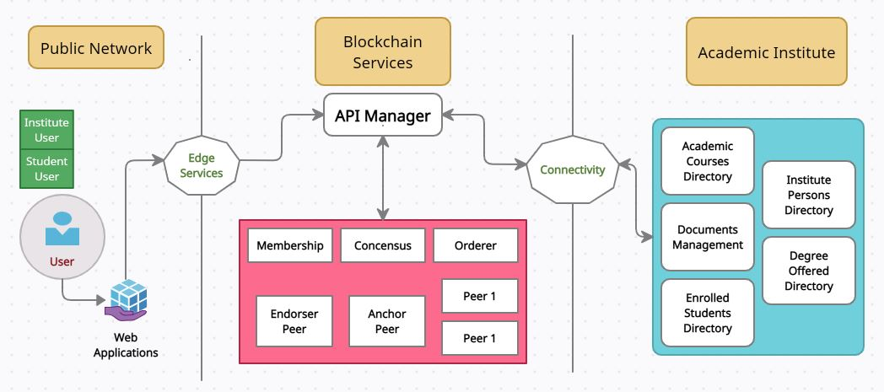
Academic Institutes based Queries and Request

Slide 3
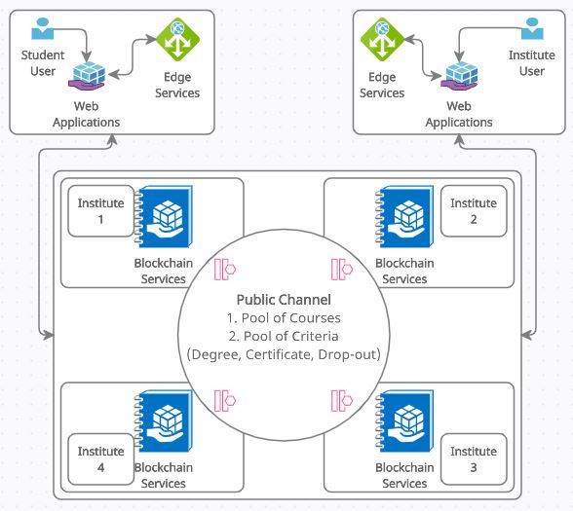
Degrees and Course Deployment

Slide 4
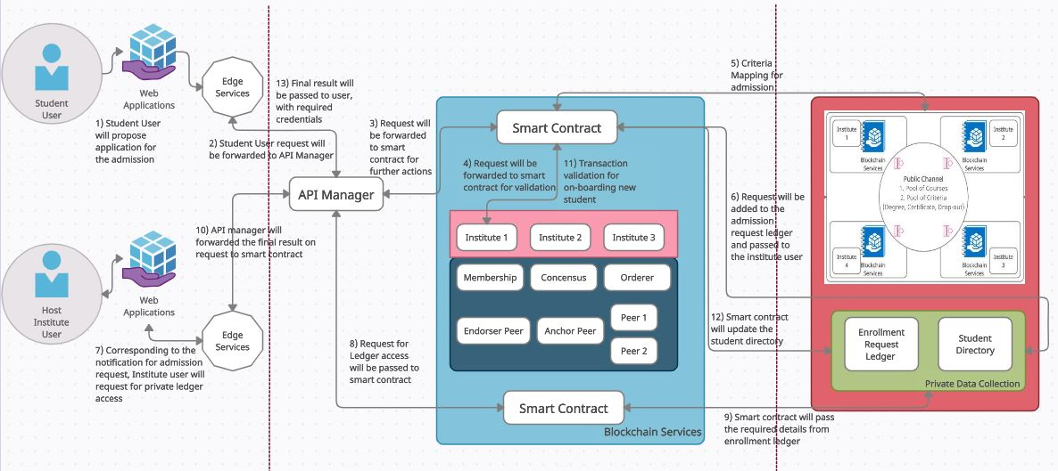
Students On boarding

Slide 5
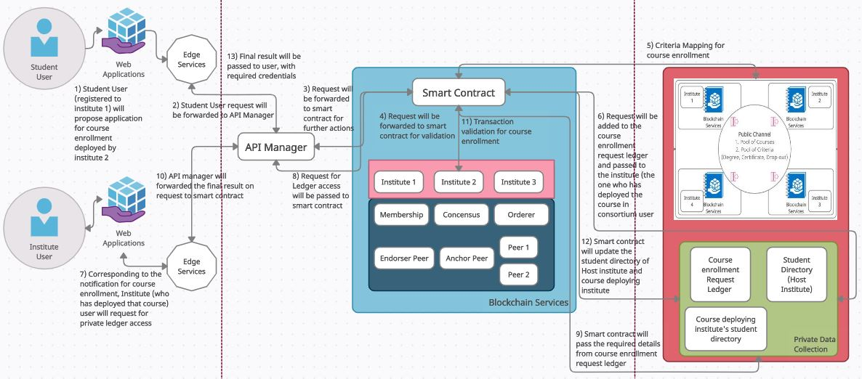
Course Enrolment

Slide 6
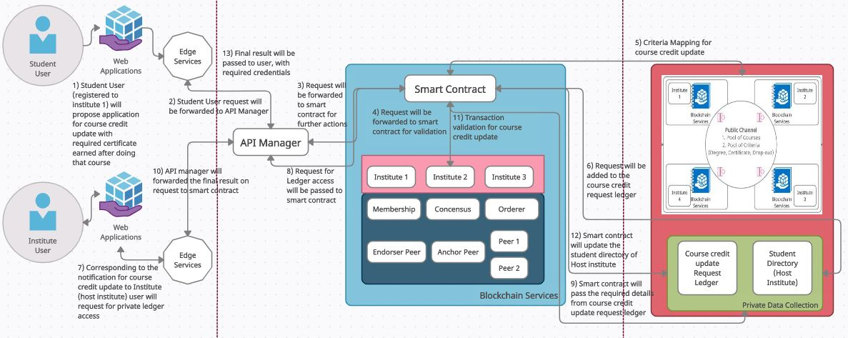
Credit Updation

Slide 7
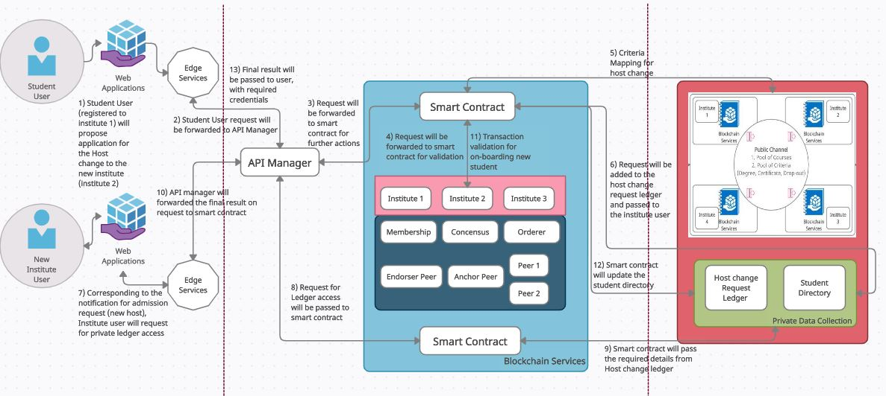
Host Change Request

Slide 8
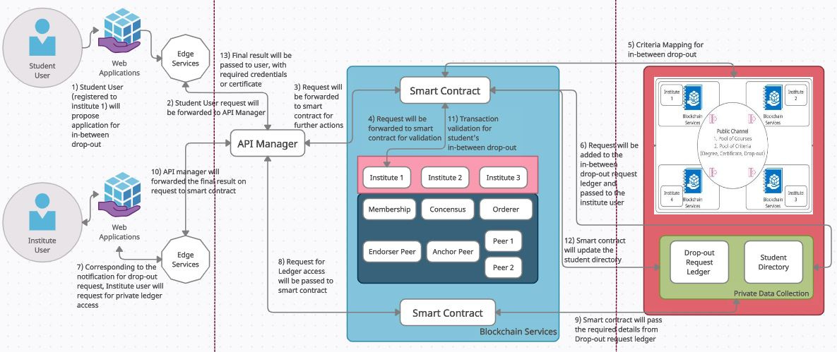
Drop-out Request

Slide 9
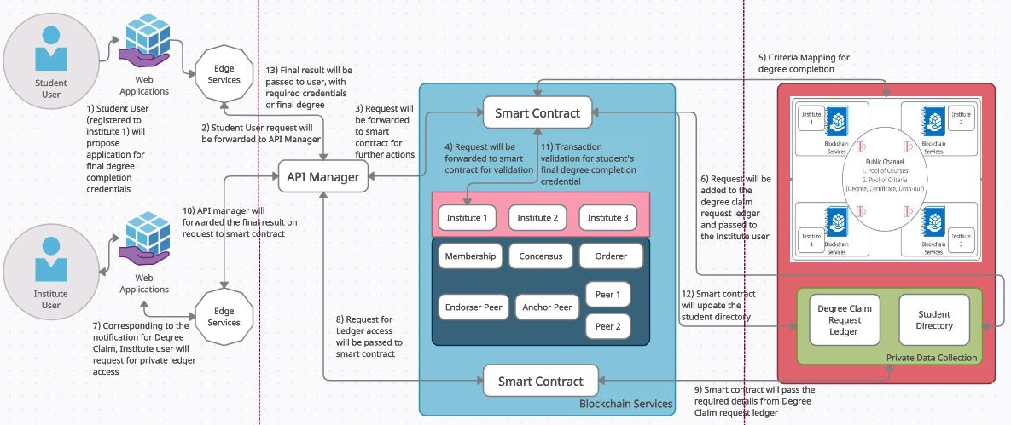
Final Award of Degree

Slide 10
List of Public Ledgers (Public Database)
Criteria Ledger (Degree Admission, Host Change, In-Between Drop-out)
Pool of Courses

Slide 11
List of Private Ledger (Private Database of Institutes)
Student Directory
Students Document
Institute Person Directory
Courses Deployed by particular institute
Degree Enrolment Request Ledger
Course Enrolment Request Ledger
Credit Update Request Ledger
Host Change Request Ledger
Drop-out Request Ledger
Final Degree Claim Request Ledger
List of students who has enrolled to course deployed by that institute

Slide 12
Main Functionalities
Criteria Deployment
Wide range of Course deployment with all details
Listing of criteria of each institutes
On boarding of Student
Listing list of available and eligible courses after student is on boarded
Course enrolment
Credit update
Host Change/Drop-out
Final Award of Degree

